Slide 1








DIGITAL. INNOVATION. SCALE

Slide 2

Agenda
Observer design patterns
What is Observer Design Pattern
When to use
Examples
Questions and answers

Slide 3
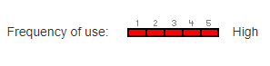
What is Observer Design Pattern
Behavioral Design Pattern
Define a one-to-many dependency between objects so that when one object changes state, all its dependents are notified and updated automatically.
The Observer design pattern solves problems like:
How can a one-to-many dependency between objects be defined without making the objects tightly coupled?
How can an object notify an open-ended-number of other objects

Slide 4
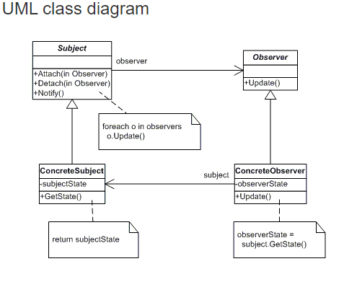
What we need for Observer Design Pattern
Subject
Observer

Slide 5
Advantages
I. Decouples subject from observers.
Subject only refers to and knows about the simple Observer Interface for updating the state
Because Subject and Observer aren't tightly coupled, they can belong to different layers of abstraction in a system.
Loosely coupled objects are easier to implement, change, test, and reuse.
II. Makes adding/withdrawing observers easy.
Observers can be added to and withdrawn from a subject independently and dynamically.
Usually, observers are responsible for registering and unregistering themselves on a subject.
Unless encapsulating and restoring Originator state is cheap, the pattern may not be appropriate.
Subject's sole responsibility is to hold a list of observers and notify them when its state changes.

Slide 6
Disadvantages
Can make the update behavior complex.
A change on the subject may cause a cascade of updates to observers and their dependent objects.
The Mediator design pattern can be applied to implement a complex dependency relationship between subject(s) and observers.

Slide 7
Questions

Slide 8
References
GOF – Design Patterns - http://www.w3sdesign.com/GoF_Design_Patterns_Reference0100.pdf
Dotfactory - https://www.dofactory.com/net/design-patterns
Code example -https://gitlab.softvision.ro/enterprise.net/design-patterns/command

